Slide 1

Data Management Roadmap
Building an Information Architecture Strategy

Slide 2

Agenda
Overview of Data Management
Data Management Vision
Data Management Roadmap
Data Management Benefits
Data Management Value Mapping
Shift in Strategy: Information Architecture
Key Messages
Investment Planning
Appendix: Data Management Framework
Appendix: Metadata Management Framework
Notes:
__________________Rogers Notes_____________________________________
What are the business drivers within your business?
Thats what we other companies see as their business drivers.
Some of them may apply to you as well. Discuss that!
What is relevant!
Discuss priorities and implications on IT!

Slide 3
Overview of Data Management
Data Management consists of 3 core areas
  Data Modeling
    Data Definitions (Elements & Attributes)
    Data Relationships (Direct & Indirect)
    Metadata (Business Rules, Constraints, Logic)
  Data Analysis
    Profiling (Patterns, Anomalies, Mapping)
    Auditing (Monitoring, Detection)
    Cleansing (Automated & Manual)
  Data Integration
    Data Sources to Data Sources
    Applications to Applications
    Batch, Real-Time, Large Data Volumes
Metadata defines the environment
Governance supports the process
METADATA
  Data Integration
  Data Analysis
Governance
METADATA
METADATA
  Data Modeling
METADATA
Notes:
__________________Rogers Notes_____________________________________
What are the business drivers within your business?
Thats what we other companies see as their business drivers.
Some of them may apply to you as well. Discuss that!
What is relevant!
Discuss priorities and implications on IT!

Slide 4
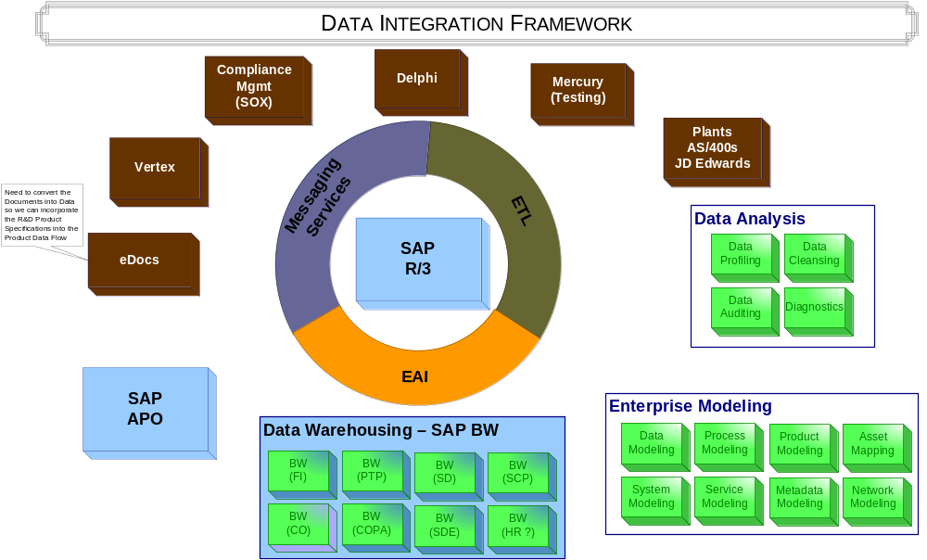
Data Management Vision
Notes:
__________________Rogers Notes_____________________________________
What are the business drivers within your business?
Thats what we other companies see as their business drivers.
Some of them may apply to you as well. Discuss that!
What is relevant!
Discuss priorities and implications on IT!

Slide 5
Data Management Roadmap
Data Integration
Integrate validated rules and processes for data governance into data processes
Automate workflows for data review and approval
Leverage approved data management services vs. system load and deploy
Improve agility of business to reduce data related process/ service constraints
Data Analysis
Update & Extend
Define rules for new processing
Support new project data governance
Continuous improvement for data models and data management processes
Cleanse, & load first waves of new data
Define & Cleanse
Benefits
Cleanse existing data
Cleanse Data processes / interfaces
Data gold source enforcement
Data Modeling
Data Model
Interfaces
KDEs / Processes
Enforce consistent, validated business rules across users and applications
Publish/Subscribe implementation / support
Structured impact analysis for data model changes
Update model based on Mfg blueprint
Data analysis based on Meta Data
Define data gold sources
Define Meta Data
Review processes against model
Q4 2006 /
Q1 2007
Q2/Q3 2007
Q4 2007 - 2008
2008 +
Notes:
__________________Rogers Notes_____________________________________
What are the business drivers within your business?
Thats what we other companies see as their business drivers.
Some of them may apply to you as well. Discuss that!
What is relevant!
Discuss priorities and implications on IT!

Slide 6
Data Management Benefits
 | Reduce Costs | Support Business Agility & Growth | Improve Stability & Scalability
Data Modeling | Reduce Manual Workload for Diagnosis Simplified analysis for identifying dependencies | Improved control enables faster change management Ability to connect strategic vision to tactical implementation | Centralized model for all data Applying metadata to data manipulation improves consistency Improve knowledge transfer
Data Analysis | Proactive cleansing & profiling reduces rework Ability to improve data ETL processes for SAP MFG project Changes to data easier to develop/integrate | Easy to adapt metadata to meet business needs Ability to integrate metadata into a single set of tools for Profiling, Auditing & Cleansing | Ability to improve data quality across each technology layers and organizational boundaries Apply Business Rules consistently
Data Integration | Ability to improve day-to-day operations Outsourcing of standard processes/services Changes to data easier to develop/integrate | Lower integration effort (applications + partners) Pre-configured business content Simplify Integration Planning Increased flexibility for planning and managing data changes | Ability to align data across the enterprise Centralized management of applied metadata Automation of manual processes Support consistency in data manipulation and transforms Automate enforcement of Business Rules

Slide 7
Data Management Value Mapping
Benefits Mapping Matrix
 | Features | Office of CIO | App Mgmt MFG, QA, R&D | App Mgmt Commercial | App Mgmt Corporate | Strat Tech & Integ | IT Ops
 | Ability to plan change & predict impact analysis BEFORE changes are applied. | X | X | X | X | X | X
 | Ability to reduce data replication |  | X | X | X | X | X
 | Ability to improve data integrity | X | X | X | X | X
 | Ability to reduce application complexity |  | X | X | X | X | X
 | Ability to reduce application support costs |  | X | X | X | X | X
 | Ability to improve application resiliency |  | X | X | X | X
 | Ability to reduce the impact of data errors to the business | X | X | X | X | X
 | Ability to build reliable data warehouses which are more adaptable & agile | X | X | X | X | X
 | Ability to build in data integrity for the existing SAP installation | X | X |  |  | X
 | Ability to proactively analyze data and build data cleansing and auditing capabilities into the SAP MFG project |  | X |  |  | X
 | Ability to reduce the support required for data investigation & resolving data errors |  | X | X | X | X
 | Ability to reduce the impact of data errors to the business | X | X | X | X | X
 | Ability to build reliable data warehouses which are more adaptable & agile | X | X | X | X | X | X
NON-SAP
SAP

Slide 8
Shift in Strategy: Information Architecture
The IT landscape is changing…
Data Integrity is a competitive necessity
Adaptability, Agility and Accountability can drive competitive advantage
Data Management is the cornerstone for building an Information Architecture
  Formalized Tools, Processes & Governance
Traditional = application-centric, ERP is the centerpiece
Progressive = Data is the foundation
= Metadata drives the enterprise
= Integration depends on data
Notes:
-------------------------------------------------------------ROGER---------------------------------------------------------------
SAP has learned that current requirements can not be delivered by a monolithic R/3 architecture.
Current restrictions:
Multiserver environment
Decentral data management
P2P integration
Poor reuse of assets/programs within SAP
Monolithic structure unlikely to adapt change
→ Integration is the story (services, partners, data…)

Slide 9

Shift in Focus: Model-Driven Approach
Traditional
Progressive
Function oriented
Build to last
Long development cycles
Process oriented
Build to change
Agility & Adoptability
Application silos
Tightly coupled
Object oriented
Known implementation
Orchestrated solutions
Loosely coupled
Message oriented
Metadata Driven
Notes:
------------------------------------------ ROGER --------------------------------------------------------
The 90s have been focusing on functional enrichment for applications and resulting best-of-breed. SAP has been the winner of the game with the top-functional ERP solution. Customers have deployed solutions around the globe and integrated them. A monolithic landscape – hardly to change – has derived from that. Examples are: BAYER !!
Today's dogma is CHANGE!
Which is hard for today's software architecture to adopt. For example see: P2P integration, supply chain integration, adopting new business models, M&A, consolidation of processes.

Slide 10
Key Message – Evolutionary Approach towards Building an Information Architecture
Tools and technologies will not automatically give you an Information Architecture
Architecture without good data will not succeed
Architecture without governance will NOT realize full value
Need to build a sustainable, scalable (doubling every 2yrs) foundation for ensuring data integrity and managing this core asset upon which business decisions are made.
Need to develop a core competency around Modeling, Analyzing & Integrating data to support business growth & the increasing pace of change.

Slide 11
Investment Planning
The investment in Tools, Processes and Governance is split into 3 separate areas:
  Data Modeling
  Data Analysis
  Data Integration
Investment Planning Summary
Breakdown | Data Modeling | Data Analysis | Data Integration | Totals
License Fees | $36,000 | $216,000 | $234,000 | $486,000
Maintenance | $3,680 | $54,000 | $58,500 | $116,180
Installation & Training Fees | $20,000 | $28,000 | $29,000 | $77,000
Hardware Purchase | $8,500 | $24,500 | $16,000 | $49,000
Projects (Implementation for SAP) | $136,200 | $233,600 | $116,800 | $486,600
Total Estimated Investment | $204,380 | $556,100 | $454,300 | $1,214,780

Slide 12
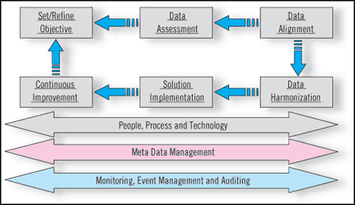
Appendix: Data Management Framework

Slide 13
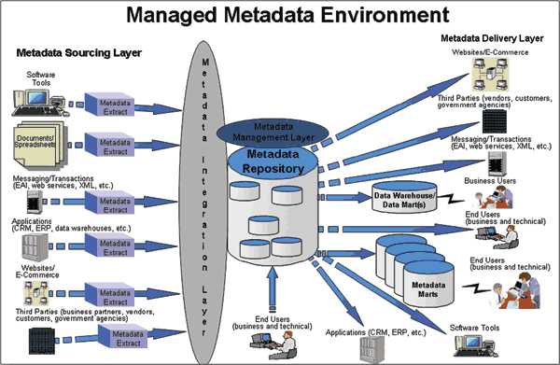
Appendix: Metadata Management Environment

